Slide 1
SQL Server Data Management

Slide 2
Objectives
Work with conditional expressions and logical operators in T-SQL
Explain how to insert data into a table using T-SQL
Explain how to update data in an existing table
Explain how to delete data from an existing table
Describe Export and import of data using conversion tools of Enterprise Manager

Slide 3
T-SQL
Transact SQL (T-SQL) enables programming functionality within relational databases provided by SQL Server 2000.
T-SQL provides several operators and conditional expressions to work with.

Slide 4

Conditional expressions
An expression is a combination of symbols and operators which can be evaluated by SQL Server to obtain a single value.
An expression may consist of one or more of the following:
  Constant
  Column
  {unary_operator}
  {binary_operator}
PRICE >100
NAME LIKE ‘RITA’
GRADE <> ‘FAIL’

Slide 5
Comparison Operators
Operator Meaning
= Equal to
> Greater than
< Less than
>= Greater than or equal to
<= Less than or equal to
<> Not equal to
! Not

Slide 6

Wildcard characters
Wildcard
Description
Example
‘_’
A single character
Select Branch_Code From Branch Where Branch_Code Like ‘L__’
%
A string of any length
Select Route_Code From FlightSchedule Where Route_Code Like ‘AMS-%’
[]
A single character within the range enclosed in the brackets
Select Airbusno From FlightSchedule Where Airbusno Like ‘AB0[1-5]’
[^]
Any single character not within the range enclosed in the brackets
Select Airbusno From FlightSchedule Where Airbusno Like ‘AB0[^1-5]’

Slide 7
Logical operators
The logical operators supported by T-SQL
AND
OR
NOT
The AND and OR operators are used to connect search conditions in WHERE clauses. NOT negates the search condition. AND joins two conditions and returns TRUE only when both conditions are true. OR also connects two conditions, but it returns TRUE when either of the conditions is true.

Slide 8
Examples of using Logical operators
PRICE <100 AND EDITION =1
CITY=‘DALLAS’ OR STATE=‘TEXAS’
MARITAL STATUS NOT=‘SINGLE’

Slide 9
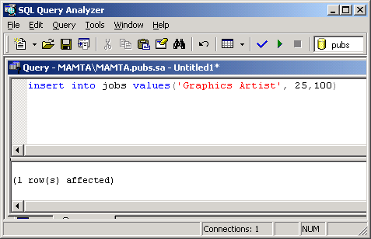
Inserting data into a Table
INSERT [INTO] <Table_name> VALUES<values>

Slide 10
Insert data from existing table into a table-1
The syntax is given below:
INSERT <table name>
SELECT <column list> FROM <tablename2>
Where table name is the name of the table
into which we want to add data, column list is
the list of columns to be selected from the
existing table and tablename2 is the name of
the existing table
Table A
Table B

Slide 11
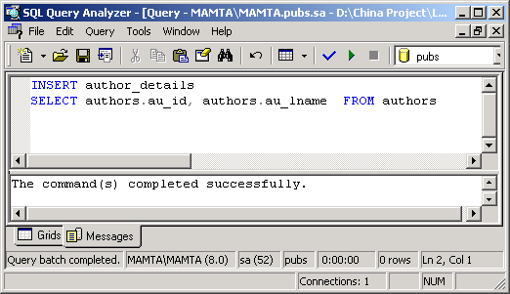
Insert data from existing table into a table-2

Slide 12
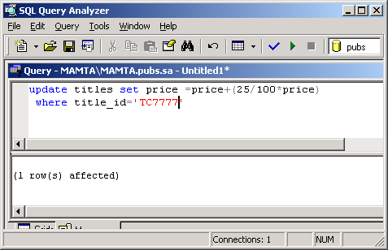
Updating Single Row
UPDATE <Table_name> SET <Column_name = Value>
[WHERE <Search condition>]

Slide 13
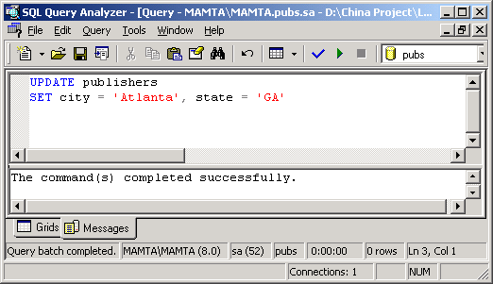
Updating multiple rows
We can also update multiple rows of a table by
omitting the WHERE clause or including such a
condition with the WHERE clause that more than
one row would be affected.

Slide 14
JOINS (1)
Syntax:
Table_A AS Table_Alias_A JOIN Table_B AS Table_Alias_B
ON
Table_Alias_A.<Common_Field> =
Table_Alias_B.<Common_Field>

Slide 15



JOINS(2)
Customer
Orders
Customer Code
Name
City
Address
Pin code
Order Number
Order Date
Customer code
Data from many tables can be viewed together if relationship exist between them
A well-defined relationship helps maintain a high-level of integrity. For example, a customer record from the customer table cannot be deleted if a record for that customer exists in the orders table.
Customer
Orders
Details of Mr. X
Details of Orders placed by Mr.X
Deletion

Slide 16

JOINS (3)
There are three types of Joins :
JOINS
INNER
SELF
OUTER

Slide 17
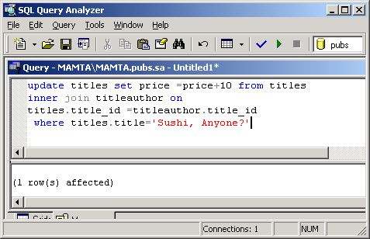
Updation using Inner Joins

Slide 18
Outer Joins
There are three types of Outer Joins
  Left Outer Join
  Right Outer Join
  Full Outer Join

Slide 19
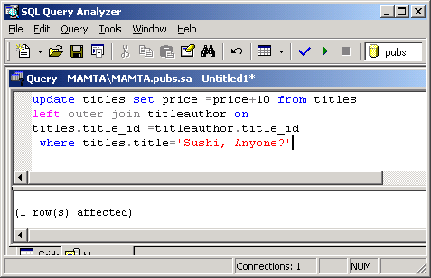
Updation using Outer Join

Slide 20
Self Join
A self-join is a type of inner join
Used to find records in a table that are related to other records in the same table

Slide 21
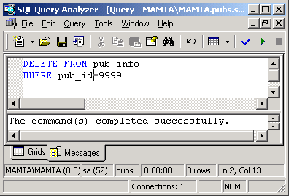
Deleting Single row of data
DELETE FROM <Table_name> [WHERE <Search_Condition>]

Slide 22
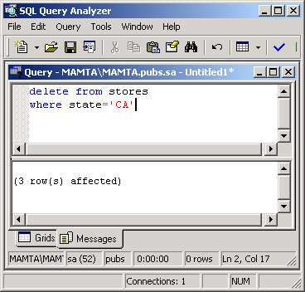
Deleting Multiple Rows of data
Multiple rows of data can deleted by omitting the
WHERE clause in the DELETE statement or writing
the WHERE with a condition such that multiple rows
will be deleted.

Slide 23
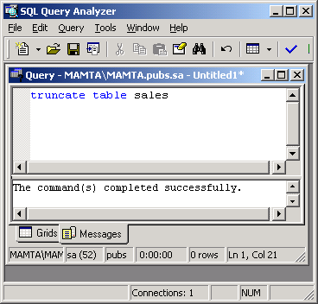
TRUNCATE TABLE
TRUNCATE TABLE is the command that we can use to delete all the rows from a table. It is functionally similar to DELETE statement without a WHERE clause.

Slide 24

Importing and exporting Data
It is possible to use data from an external data source with SQL Server. This is called importing data.
It is also possible to send data from an SQL Server database to an external data source. This is called exporting data.
We can import and export data by using
  Import/Export item in the Microsoft SQL Server program group
  Using Import/Export options in the Enterprise Manager

